Slide 1
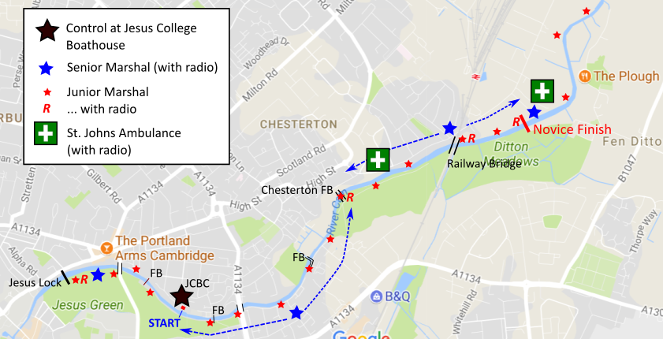

Slide 2
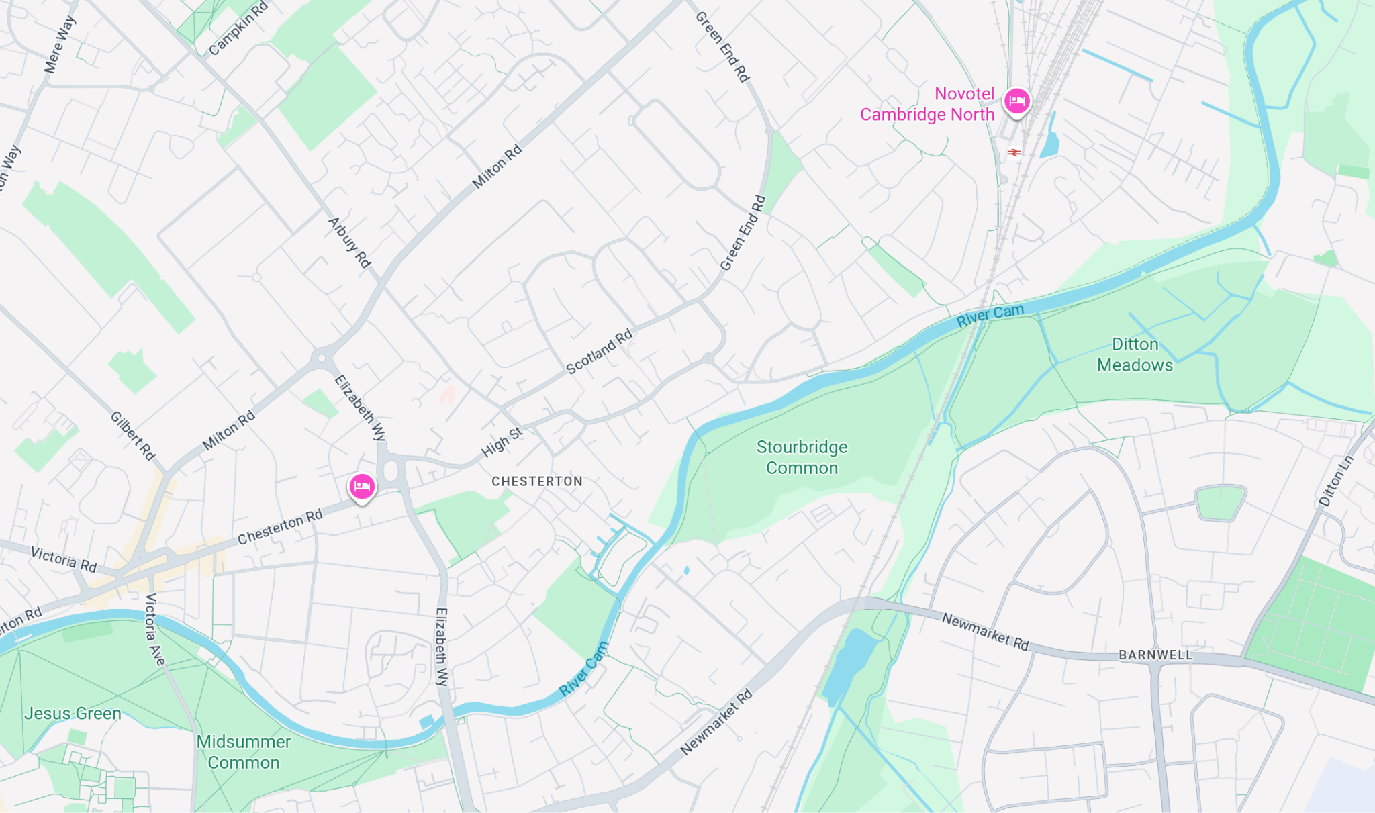
Junior umpire, with radio
R
Race control (JCBC)
Mobile First aider (bikes, radios)
Senior umpir, with radio
R
R
R

